Slide 1
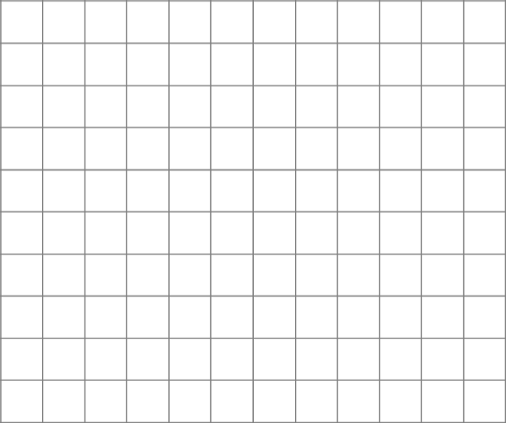

Checking understanding of similarity
Task A: Checking understanding of enlargement
1) a) Enlarge the object by a scale factor of 3 from the point marked.
b) Use a ruler to measure all of the lengths on each shape and check that each length on the image is 3 times its corresponding length on the object.
c) Use a protractor to measure all of the angles on each shape and check that each angle on the image is equal to its corresponding angle on the object.
2) Jun wants to enlarge the shape by a scale factor of 2. He needs to choose the centre of enlargement carefully so that all of the image stays on the grid.
Find all the points which Jun could use for the centre of enlargement.

Slide 2
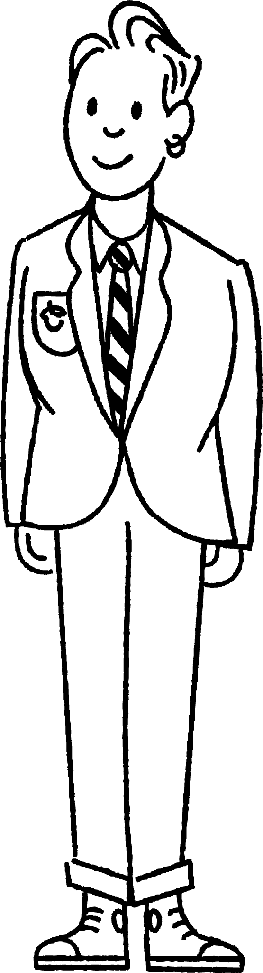
Checking understanding of similarity
Task B: Checking understanding of similarity
1) Use similarity to find the missing lengths.
a)
b)
70 inches
140 inches
?
148 cm
370 cm
15.25 m
?
2) a) Match each triangle with its similar triangle. b) Find the scale factor between each pair of similar triangles.
29
10
5
12.5
7.5
D
10.5
A
12
B
C
14.5
13
20
21
10
34
5
3
G
39
F
4
15
E
16
30
15
8
H
36
17
Mathematics in Education and Industry
v2.3

